Slide 1

Introduction to OpenCV

Slide 2
OpenCV
OpenCV (Open Source Computer Vision Library) is an open source computer vision and machine learning software library
3.4.0 / 2.4.13.5 (Latest version: OpenCV 4.7 )
OpenCV-Python is the Python API of OpenCV
Cross-platform (Windows, Mac, Linux, Android, iOS, etc )
Open Source and free (May have some commercial packages)
Documentation: http://docs.opencv.org/modules/core/doc/intro.html

Slide 3
Installation
Install OpenCV-Python in Windows (site)
Install Anaconda
Anaconda is essentially a nicely packaged Python IDE that is shipped with tons of useful packages, such as NumPy, Pandas, IPython Notebook, etc.
Installation: https://docs.anaconda.com/anaconda/install/
Install python virtual environment on Anaconda
https://docs.conda.io/projects/conda/en/latest/user-guide/tasks/manage-environments.html
Install opencv-python:
Test:
Open Python IDLE and type following codes in Python terminal
$ pip install opencv-python
>>> import cv2
>>> print(cv2.__version__)

Slide 4
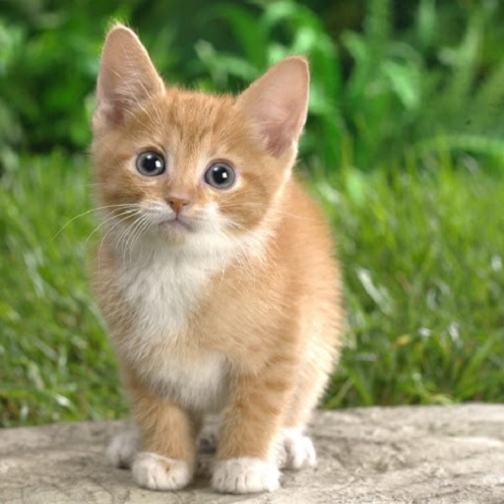
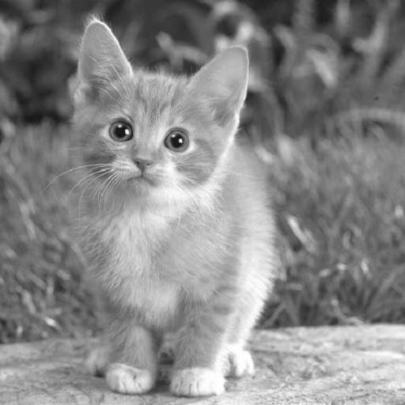
Reading, Colorspace Changing:
import cv2
# reading image:
image = cv2.imread(‘cat.jpg’) # default
image = cv2.imread(‘cat.jpg’, 1) # colorful, BGR
image = cv2.imread(‘cat.jpg’, 0) # gray-scale
image = cv2.imread(‘cat.jpg’, -1) # unchanged, e.g., images include alpha channel
Notes:
NumPy N-dimensional array

Slide 5
Reading, Colorspace Changing:
import cv2
# change image colorspace:
image = cv2.imread(‘cat.jpg’) # default, BGR
image2 = cv2.cvtColor(image, flag)
flag:
BGR->Gray: cv2.COLOR_BGR2GRAY
BGR->RGB: cv2.COLOR_BGR2RGB
BGR->HSV: cv2.COLOR_BGR2HSV

Slide 6
Image Segmentation
K-means Clustering
It clusters the given data into k-clusters or parts based on the k-centroids
The motivation behind image segmentation using k-means is that we try to assign labels to each pixel based on the RGB (or HSV) values
OpenCV
cv2.kmeans(data, K, criteria, attempts, flags[, bestLabels[, centers]]) → retval, bestLabels, centers
Input parameters
data: np.float32 data type, and each feature should be put in a single column
K : Number of clusters required at end
criteria : It is the iteration termination criteria
attempts: Flag to specify the number of times the algorithm is executed
flags: how initial centers are taken
Output parameters
retval: the sum of squared distance from each point to their corresponding centers
bestLabels: the label array where each element marked ‘0’, ‘1’,......, ‘K-1’
centers: array of centers of clusters

Slide 7
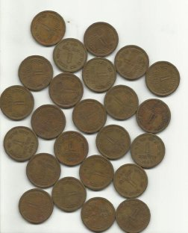

Image Segmentation
Preprocessing
Convert the MxNx3 image into a Kx3 matrix (K=MxN)
import numpy as np
import cv2
from matplotlib import pyplot as plt
image = cv2.imread('coins.jpg')
# reduce noise and make the image smoother
image = cv2.GaussianBlur(image, (7, 7), 0)
# each row is now a vector in the 3-D space of RGB
vectorized = image.reshape(-1, 3)
# convert the unit8 values to float (cv2.kmeans requirement)
vectorized = np.float32(vectorized)
Input
Noise Removal

Slide 8
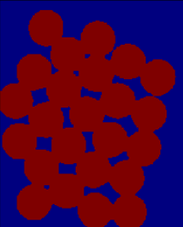
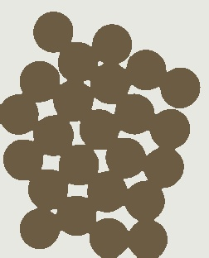
Image Segmentation
k-means algorithm
# define number of segments, with default 5
segments = 2
# OpenCV k-means function
criteria = (cv2.TERM_CRITERIA_EPS + cv2.TERM_CRITERIA_MAX_ITER, 10, 1.0)
ret, label, center = cv2.kmeans(vectorized, segments, None, criteria, 10, cv2.KMEANS_RANDOM_CENTERS)
# assign every pixel with a color based on the label map
res = center[label.flatten()]
# reshape to image size
segmented_map = res.reshape((image.shape))
result = segmented_map.astype(np.uint8)
cv2.imwrite("segmented.jpg", result)
Label map
Segmentation map
Notes:
https://github.com/rcrespocano/opencv-python/issues/5

Slide 9
Feature Matching
SIFT
OpenCV 3 came a big push to move many of these “non-free” modules out of the default OpenCV install and into the opencv_contrib package
To get access to the original SIFT and SURF implementations found in OpenCV 2.4.X, you need to pull down both the opencv and opencv_contrib repositories from GitHub and then compile and install OpenCV 3 from source
ORB
An efficient alternative to SIFT or SURF
A fusion of FAST keypoint detector and BRIEF descriptor

Slide 10
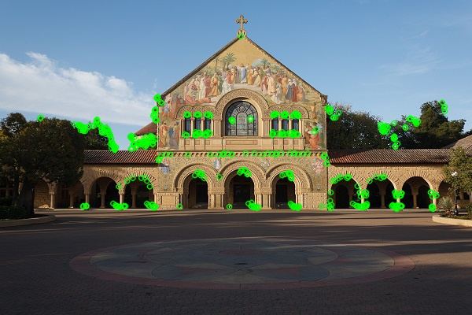
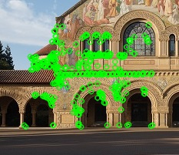
Feature Matching
Example
import numpy as np
import cv2
img1 = cv2.imread('church.jpg',0) # queryImage
img2 = cv2.imread('church_part.jpg',0) # trainImage
# Initiate detector
orb = cv2.ORB_create()
# find the keypoints and descriptors
kp1, des1 = orb.detectAndCompute(img1,None)
kp2, des2 = orb.detectAndCompute(img2,None)

Slide 11
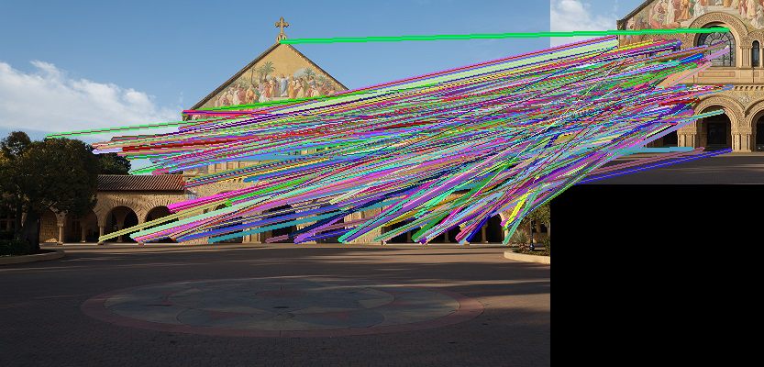
Feature Matching
Brute-Force matcher
It takes the descriptor of one feature in first set and matches it with all other features in second set using some distance calculation
The closest one is returned
# create BFMatcher object
bf = cv2.BFMatcher(cv2.NORM_HAMMING, crossCheck=True)
# Match descriptors
matches = bf.match(des1,des2)
# Sort them in the order of their distance
matches = sorted(matches, key = lambda x:x.distance)

Slide 12
Feature Matching
# Draw first 10 matches using random colors
h1, w1 = img1.shape[:2]
h2, w2 = img2.shape[:2]
img3 = np.zeros((max(h1, h2), w1 + w2, 3), np.uint8)
img3[:h1, :w1, 0] = img1
img3[:h2, w1:, 0] = img2
img3[:, :, 1] = img3[:, :, 0]
img3[:, :, 2] = img3[:, :, 0]
for m in matches[:10]:
# draw the keypoints
color = tuple([np.random.randint(0, 255) for _ in xrange(3)])
cv2.line(img3, (int(kp1[m.queryIdx].pt[0]), int(kp1[m.queryIdx].pt[1])),
(int(kp2[m.trainIdx].pt[0] + w1),
int(kp2[m.trainIdx].pt[1])), color, 3)
cv2.imwrite("result.jpg", img3)

Slide 13
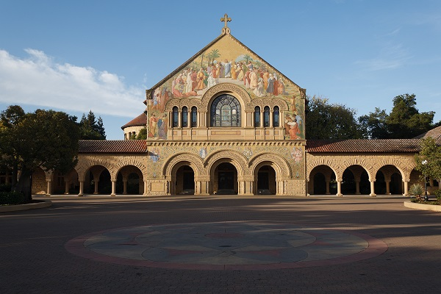
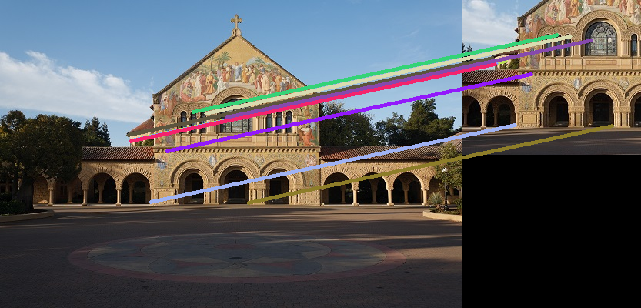
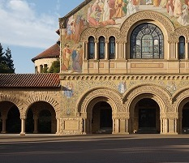
Feature Matching
Input
Output

Slide 14
Face Tracking
Haar feature-based cascade classifiers is an effective object detection method
Group the features into different stages of classifiers and apply one-by-one
If a window fails the first stage, discard it.
If it passes, apply the second stage of features and continue the process
The window which passes all stages is a face region
OpenCV contains many pre-trained classifiers for face, eyes, smile etc.
Those XML files are stored in opencv/data/haarcascades/ folder

Slide 15
Face Tracking
Example
import cv2
# face detector
faceCascade = cv2.CascadeClassifier("haarcascade_frontalface_default.xml")
# use camera
# video_capture = cv2.VideoCapture(0)
# use input video
video_capture = cv2.VideoCapture(‘input.avi’)
# Define the codec and output video
fourcc = cv2.VideoWriter_fourcc(*'XVID')
out = cv2.VideoWriter('output.avi',fourcc, 20.0, (160,112))
Notes:
https://github.com/opencv/opencv/tree/17234f82d025e3bbfbf611089637e5aa2038e7b8/data/haarcascades

Slide 16
Face Tracking
while True:
# Capture frame-by-frame
ret, frame = video_capture.read()
if frame is None:
break
gray = cv2.cvtColor(frame, cv2.COLOR_BGR2GRAY)
faces = faceCascade.detectMultiScale(gray, 1.3, 5)
# Draw a rectangle around the faces
for (x, y, w, h) in faces:
cv2.rectangle(frame, (x, y), (x+w, y+h), (0, 255, 0), 2)
# write frame to video
out.write(frame)
# When everything is done, release the capture
video_capture.release()
out.release()
Notes:
https://docs.opencv.org/3.4.0/d1/de5/classcv_1_1CascadeClassifier.html

Slide 17
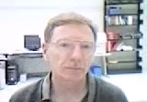
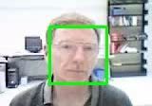
Face Tracking
Result
Input
Output

